Slide 1


WHAT DRIVES ME?
  Exploring AI & robotics
  Solving complex problems
  Creating real-world applications

Slide 2
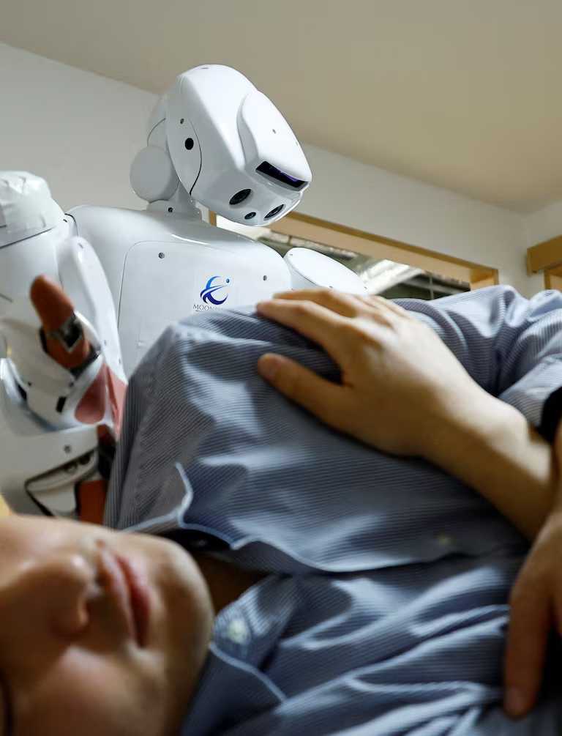
HOW I WANT TO MAKE AN IMPACT
  AI for healthcare & safety
  Smart robotics solutions
  Accessible technology for all

Slide 3

MY DREAM FIRST JOB
  Role: AI/Robotics Engineer
  Team: Innovative & collaborative
  Company: AI start-up or research lab

Slide 4
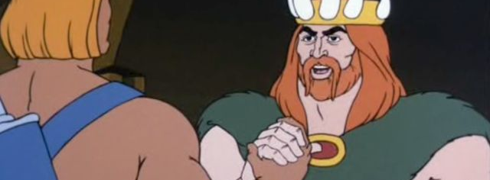
THANK YOU

